Slide 1
CS 2160 Memory Hierarchy
Chapter 5

Slide 2
Memory Technology
§5.1 Introduction
Static RAM (SRAM)
0.5ns – 2.5ns, $2000 – $5000 per GB (2014 $1000/GB)
Dynamic RAM (DRAM)
50ns – 70ns, $20 – $75 per GB (2014 $8/GB)
USB Flash
30ns – 60 ns, (2014 $0.94/GB)
Magnetic disk
5ms – 20ms, $0.20 – $2 per GB (2014 $0.04/GB)
Ideal memory
Access time of SRAM
Capacity and cost/GB of disk
375

Slide 3
Principle of Locality
Programs access a small proportion of their address space at any time
Temporal locality
Items accessed recently are likely to be accessed again soon
e.g., instructions in a loop, induction variables
Spatial locality
Items near those accessed recently are likely to be accessed soon
E.g., sequential instruction access, array data
375

Slide 4
Taking Advantage of Locality
Memory hierarchy
Store everything on disk
Copy recently accessed (and nearby) items from disk to smaller DRAM memory
Main memory
Copy more recently accessed (and nearby) items from DRAM to smaller SRAM memory
Cache memory attached to CPU
375

Slide 5
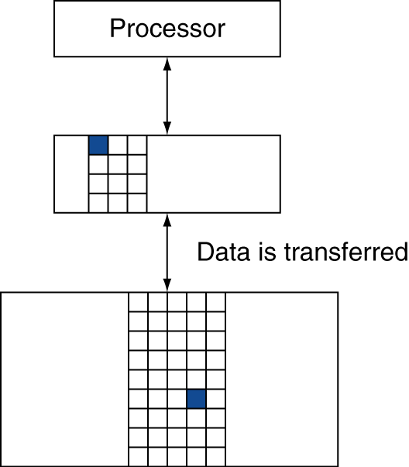
Memory Hierarchy Levels
Block (aka line): unit of copying
May be multiple words
If accessed data is present in upper level
Hit: access satisfied by upper level
Hit ratio: hits/accesses
If accessed data is absent
Miss: block copied from lower level
Time taken: miss penalty
Miss ratio: misses/accesses = 1 – hit ratio
Then accessed data supplied from upper level
375

Slide 6
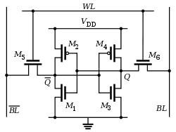
Static RAM Technology
Typically 6 transistors per bit
State stored as a stable state among transistors
Other designs trade power for number of transistors.
379

Slide 7
Dynamic RAM Technology
Charge stored as capacitance, not a transistor state
Fewer transistors (1-2), less current than SRAM
Charge only lasts a few milliseconds
Refresh cycle reads and rewrites each bit
Synchronous DRAM can transfer long blocks of bits without intermittently specifying an address
379

Slide 8
Double Data Rate DRAM
A type of SDRAM
Transfers data on rising and falling edge of clock cycle
DDR3: 400 - 1066 MHz, therefore up to 2133 M transfers/sec (64 bits wide)
Main memory typically provided with 4-16 DRAM chips on a DIMM board
4-8 byte bus width
380

Slide 9
Flash Memory
Based on EEPROM technology (Electrically Erasable Programmable Read Only Memory)
State stored as the polarity of a charged substance
Has a limited number of writes
Wear leveling used to distribute writes among blocks of memory
Can also be done by OS
SSD drives have DRAM buffers
381

Slide 10
Disk Memory
Disk composed of platters
Top and bottom of platter hold data
Access time composed of seek time and rotational latency
382

Slide 11
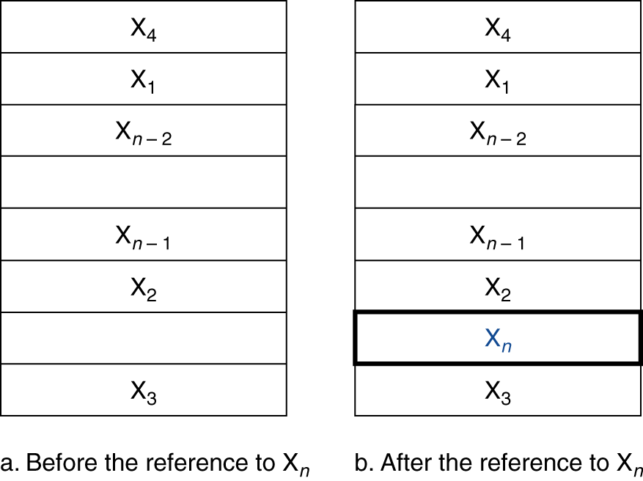
Cache Memory
Cache memory
The level of the memory hierarchy closest to the CPU
Given accesses X₁, …, X_{n–1}, X_{n}
§5.2 The Basics of Caches
How do we know if the data is present?
Where do we look?
385

Slide 12
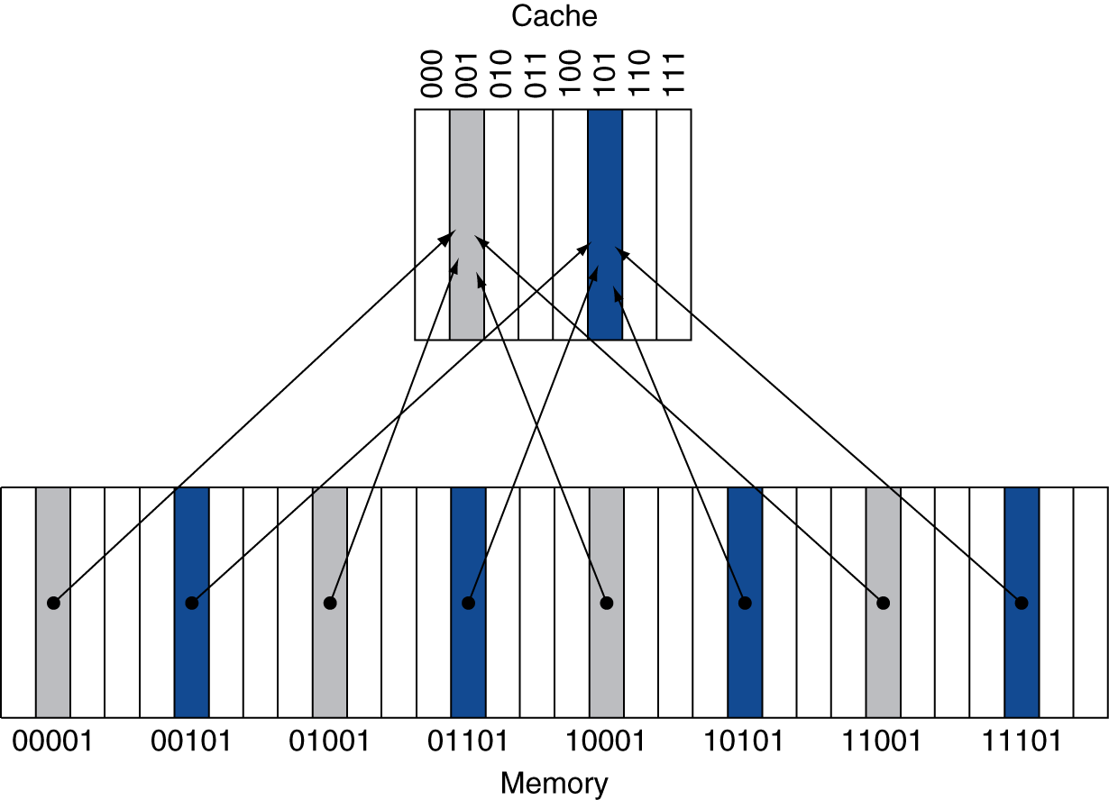
Direct Mapped Cache
Location determined by address
Direct mapped: only one choice
(Block address) modulo (#Blocks in cache)
#Blocks is a power of 2
Use low-order address bits
385

Slide 13
Tags and Valid Bits
How do we know which particular block is stored in a cache location?
Store block address as well as the data
Actually, only need the high-order bits
Called the tag
What if there is no data in a location?
Valid bit: 1 = present, 0 = not present
Initially 0

Slide 14
Cache Example
8-blocks, 1 word/block, direct mapped
Initial state
Index | V | Tag | Data
000 | N
001 | N
010 | N
011 | N
100 | N
101 | N
110 | N
111 | N

Slide 15
Cache Example
Dec word addr | Binary addr | Hit/miss | Cache block
22 | 10 110 | Miss | 110
Index | V | Tag | Data
000 | N
001 | N
010 | N
011 | N
100 | N
101 | N
110 | Y | 10 | Mem[10110]
111 | N
386

Slide 16
Cache Example
Word addr | Binary addr | Hit/miss | Cache block
26 | 11 010 | Miss | 010
Index | V | Tag | Data
000 | N
001 | N
010 | Y | 11 | Mem[11010]
011 | N
100 | N
101 | N
110 | Y | 10 | Mem[10110]
111 | N

Slide 17
Cache Example
Word addr | Binary addr | Hit/miss | Cache block
22 | 10 110 | Hit | 110
26 | 11 010 | Hit | 010
Index | V | Tag | Data
000 | N
001 | N
010 | Y | 11 | Mem[11010]
011 | N
100 | N
101 | N
110 | Y | 10 | Mem[10110]
111 | N

Slide 18
Cache Example
Word addr | Binary addr | Hit/miss | Cache block
16 | 10 000 | Miss | 000
3 | 00 011 | Miss | 011
16 | 10 000 | Hit | 000
Index | V | Tag | Data
000 | Y | 10 | Mem[10000]
001 | N
010 | Y | 11 | Mem[11010]
011 | Y | 00 | Mem[00011]
100 | N
101 | N
110 | Y | 10 | Mem[10110]
111 | N

Slide 19
Cache Example
Word addr | Binary addr | Hit/miss | Cache block
18 | 10 010 | Miss | 010
Index | V | Tag | Data
000 | Y | 10 | Mem[10000]
001 | N
010 | Y | 10 | Mem[10010]
011 | Y | 00 | Mem[00011]
100 | N
101 | N
110 | Y | 10 | Mem[10110]
111 | N

Slide 20
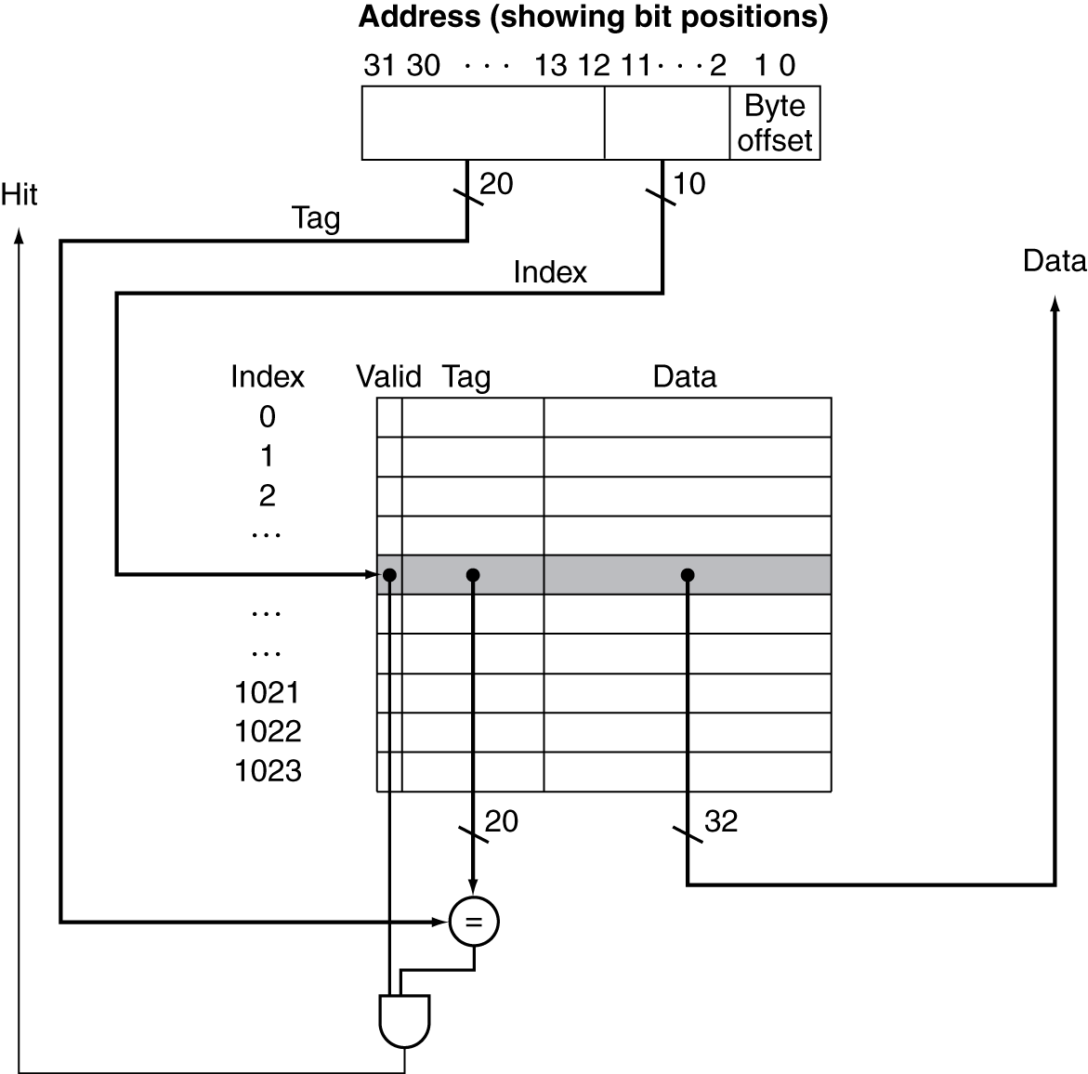
Address Subdivision
389

Slide 21
Example: Larger Block Size
64 blocks, 16 bytes/block
To what block number does address 1200 map?
Block address = ⎣1200/16⎦ = 75
Block number = 75 modulo 64 = 11
31
10
9
4
3
0
Tag
Index
Offset
22 bits
6 bits
4 bits

Slide 22
Block Size Considerations
Larger blocks should reduce miss rate
Due to spatial locality
But in a fixed-sized cache
Larger blocks ⇒ fewer of them
More competition ⇒ increased miss rate
Larger blocks ⇒ pollution
Larger miss penalty
Can override benefit of reduced miss rate
Early restart and critical-word-first can help

Slide 23
Miss Rate vs Block Size
391

Slide 24
Cache Misses
On cache hit, CPU proceeds normally
On cache miss
Stall the CPU pipeline
Fetch block from next level of hierarchy
Instruction cache miss
Restart instruction fetch
Data cache miss
Complete data access
392

Slide 25
Write-Through
On data-write hit, could just update the block in cache
But then cache and memory would be inconsistent
Write through: also update memory
But makes writes take longer
e.g., if base CPI = 1, 10% of instructions are stores, write to memory takes 100 cycles
Effective CPI = 1 + 0.1×100 = 11
Solution: write buffer
Holds data waiting to be written to memory
CPU continues immediately
Only stalls on write if write buffer is already full
393

Slide 26
Write-Back
Alternative: On data-write hit, just update the block in cache
Keep track of whether each block is dirty
When a dirty block is replaced
Write it back to memory
Can use a write buffer to allow replacing block to be read first
394

Slide 27
Write Allocation
What should happen on a write miss?
Alternatives for write-through
Allocate on miss: fetch the block
Write around: don’t fetch the block
Since programs often write a whole block before reading it (e.g., initialization)
For write-back
Usually fetch the block

Slide 28
Example: Intrinsity FastMATH
Embedded MIPS processor
12-stage pipeline
Instruction and data access on each cycle
Split cache: separate I-cache and D-cache
Each 16KB: 256 blocks × 16 words/block
D-cache: write-through or write-back
SPEC2000 miss rates
I-cache: 0.4%
D-cache: 11.4%
Weighted average: 3.2%
395

Slide 29
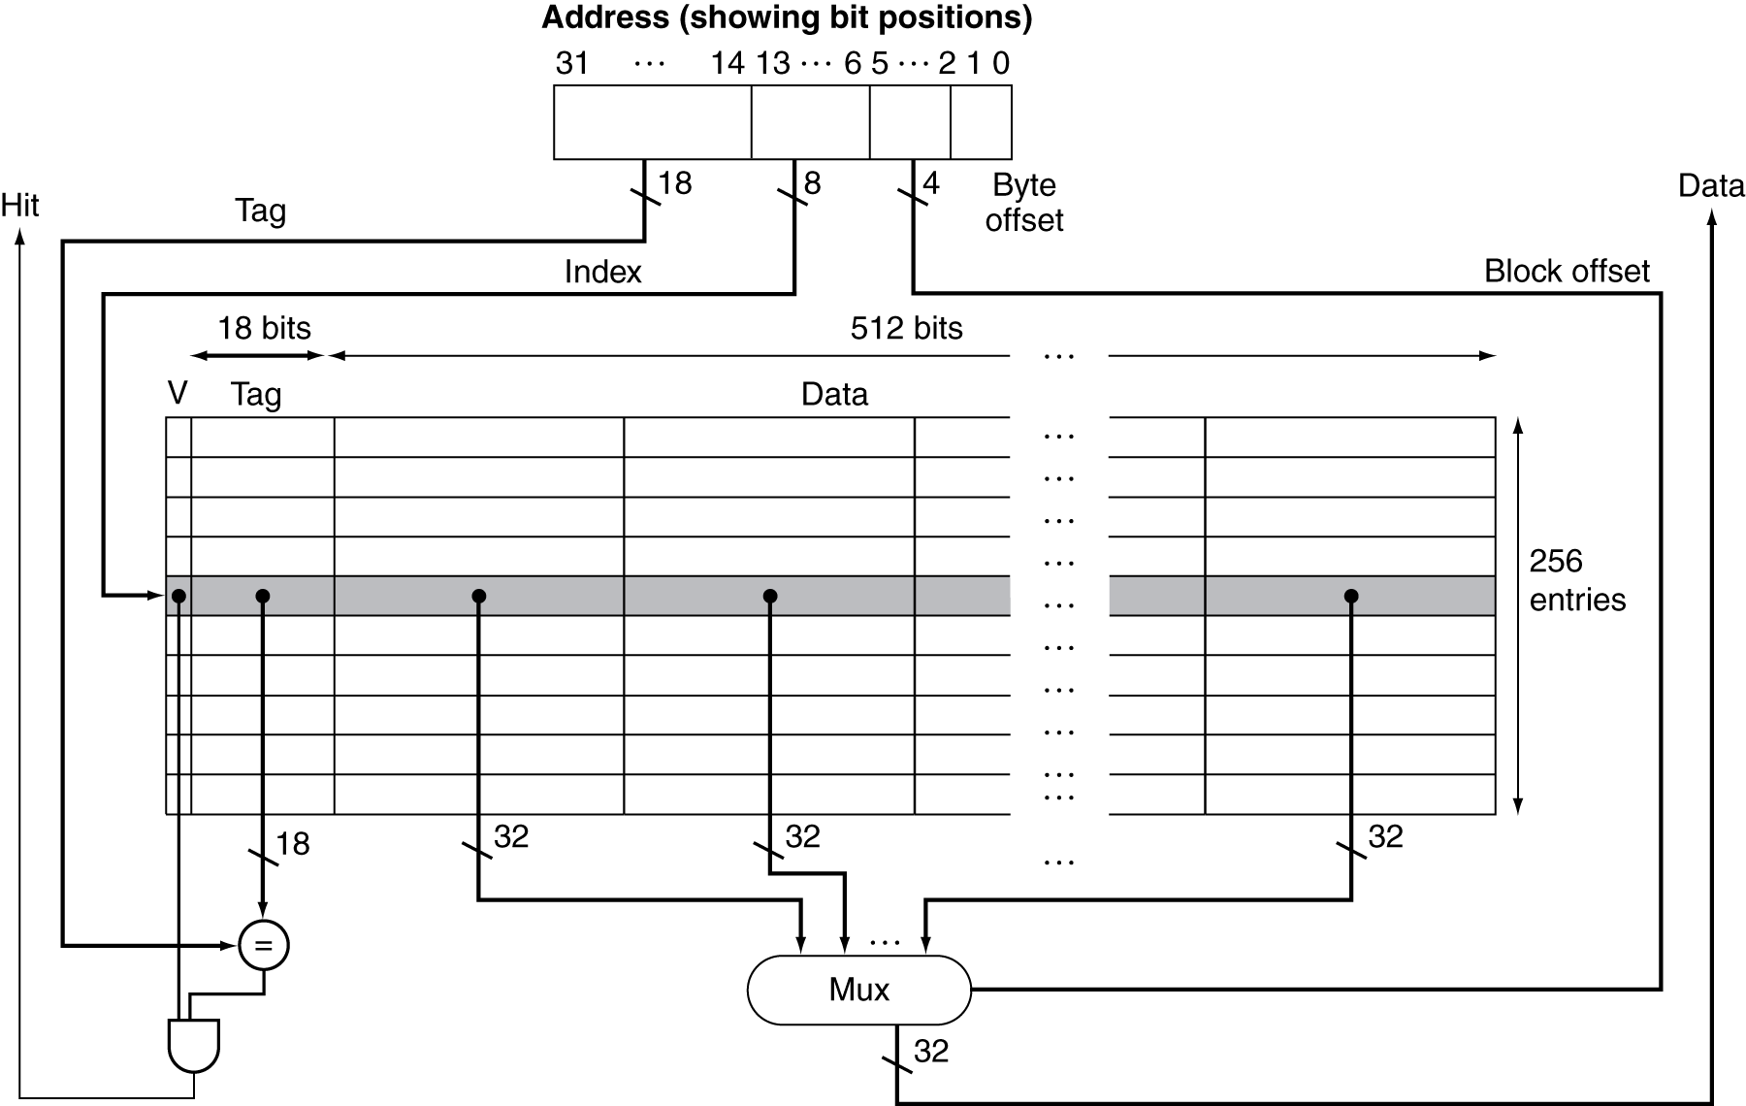
Example: Intrinsity FastMATH
396

Slide 30
Main Memory Supporting Caches
Use DRAMs for main memory
Fixed width (e.g., 1 word)
Connected by fixed-width clocked bus
Bus clock is typically slower than CPU clock
Example cache block read
1 bus cycle for address transfer
15 bus cycles per DRAM access
1 bus cycle per data transfer
For 4-word block, 1-word-wide DRAM
Miss penalty = 1 + 4×15 + 4×1 = 65 bus cycles
Bandwidth = 16 bytes / 65 cycles = 0.25 B/cycle

Slide 31
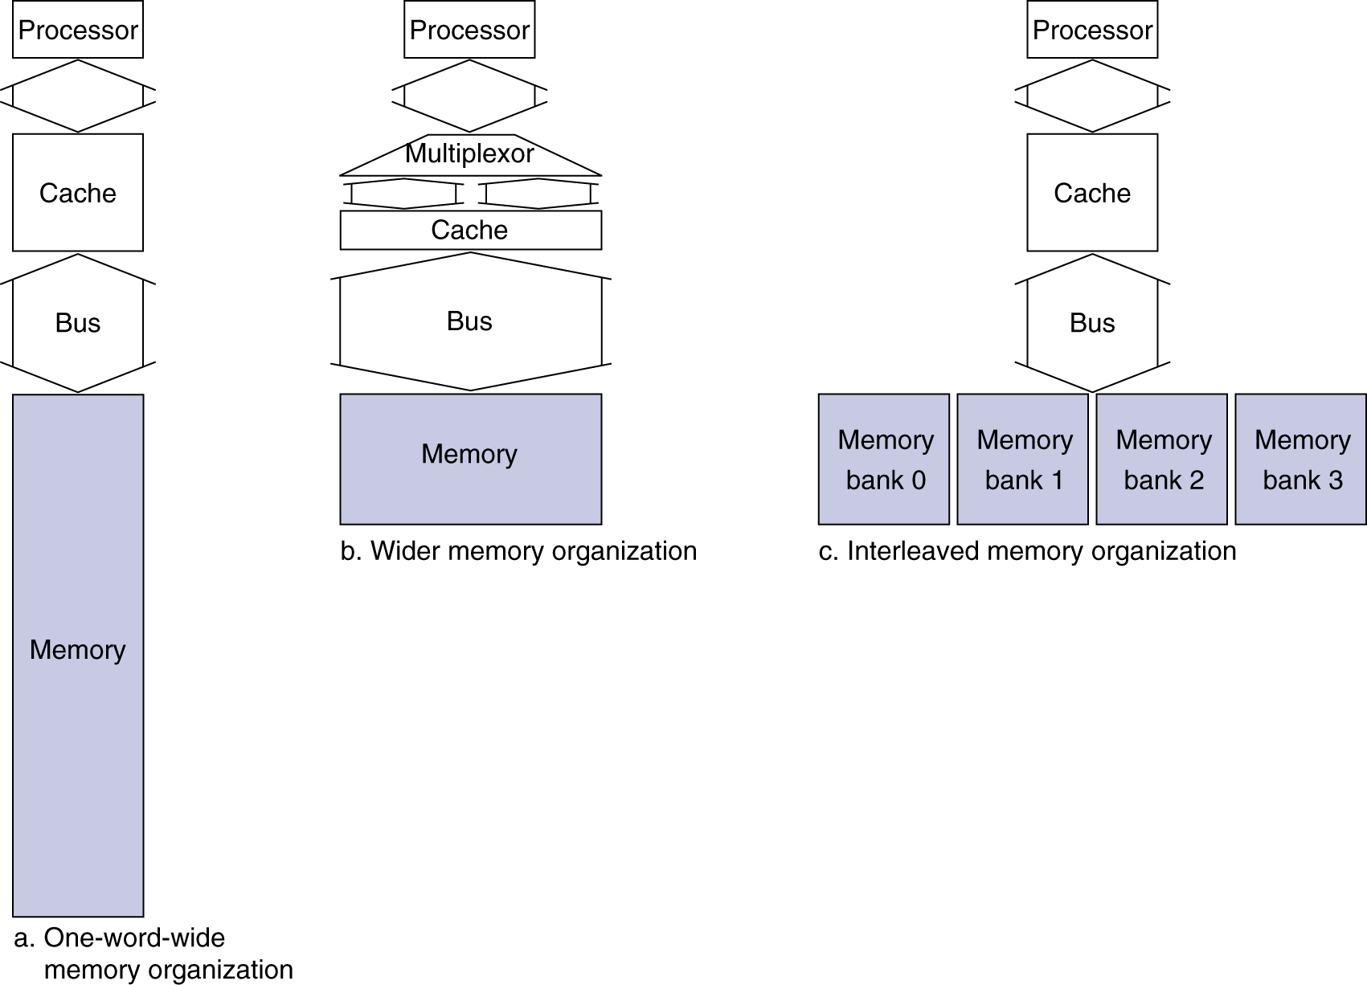
Increasing Memory Bandwidth
4-word wide memory
Miss penalty = 1 + 15 + 1 = 17 bus cycles
Bandwidth = 16 bytes / 17 cycles = 0.94 B/cycle
4-bank interleaved memory
Miss penalty = 1 + 15 + 4×1 = 20 bus cycles
Bandwidth = 16 bytes / 20 cycles = 0.8 B/cycle

Slide 32
Advanced DRAM Organization
Bits in a DRAM are organized as a rectangular array
DRAM accesses an entire row
Burst mode: supply successive words from a row with reduced latency
Double data rate (DDR) DRAM
Transfer on rising and falling clock edges
Quad data rate (QDR) DRAM
Separate DDR inputs and outputs

Slide 33
DRAM Generations
Year | Capacity | $/GB
1980 | 64Kbit | $1500000
1983 | 256Kbit | $500000
1985 | 1Mbit | $200000
1989 | 4Mbit | $50000
1992 | 16Mbit | $15000
1996 | 64Mbit | $10000
1998 | 128Mbit | $4000
2000 | 256Mbit | $1000
2004 | 512Mbit | $250
2007 | 1Gbit | $50

Slide 34
Measuring Cache Performance
Components of CPU time
Program execution cycles
Includes cache hit time
Memory stall cycles
Mainly from cache misses
With simplifying assumptions:
§5.3 Measuring and Improving Cache Performance

Slide 35
Cache Performance Example
Given
I-cache miss rate = 2%
D-cache miss rate = 4%
Miss penalty = 100 cycles
Base CPI (ideal cache) = 2
Load & stores are 36% of instructions
Miss cycles per instruction
I-cache: 0.02 × 100 = 2
D-cache: 0.36 × 0.04 × 100 = 1.44
Actual CPI = 2 + 2 + 1.44 = 5.44
Ideal CPU is 5.44/2 =2.72 times faster
401

Slide 36
Average Access Time
Hit time is also important for performance
Average memory access time (AMAT)
AMAT = Hit time + Miss rate × Miss penalty
Example
CPU with 1ns clock, hit time = 1 cycle, miss penalty = 20 cycles, I-cache miss rate = 5%
AMAT = 1 + 0.05 × 20 = 2ns
2 cycles per instruction
402

Slide 37
Performance Summary
When CPU performance increased
Miss penalty becomes more significant
Decreasing base CPI
Greater proportion of time spent on memory stalls
Increasing clock rate
Memory stalls account for more CPU cycles
Can’t neglect cache behavior when evaluating system performance

Slide 38
Associative Caches
Fully associative
Allow a given block to go in any cache entry
Requires all entries to be searched at once
Comparator per entry (expensive)
n-way set associative
Each set contains n entries
Block number determines which set
(Block number) modulo (#Sets in cache)
Search all entries in a given set at once
n comparators (less expensive)
403

Slide 39
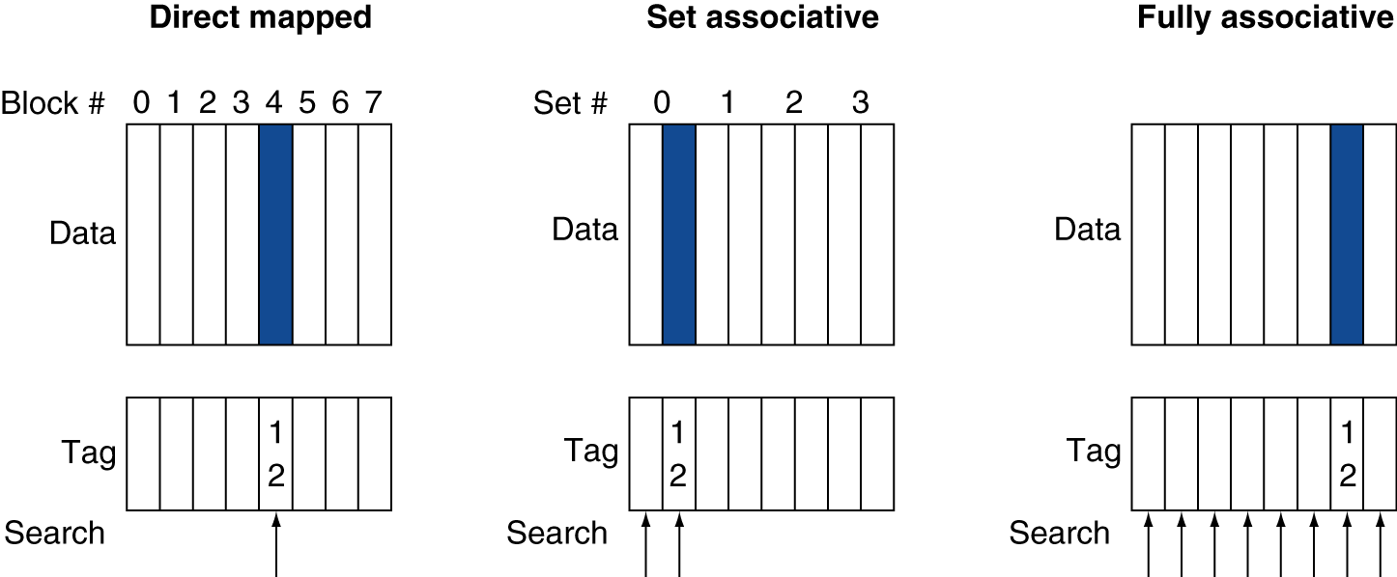
Associative Cache Example
403

Slide 40
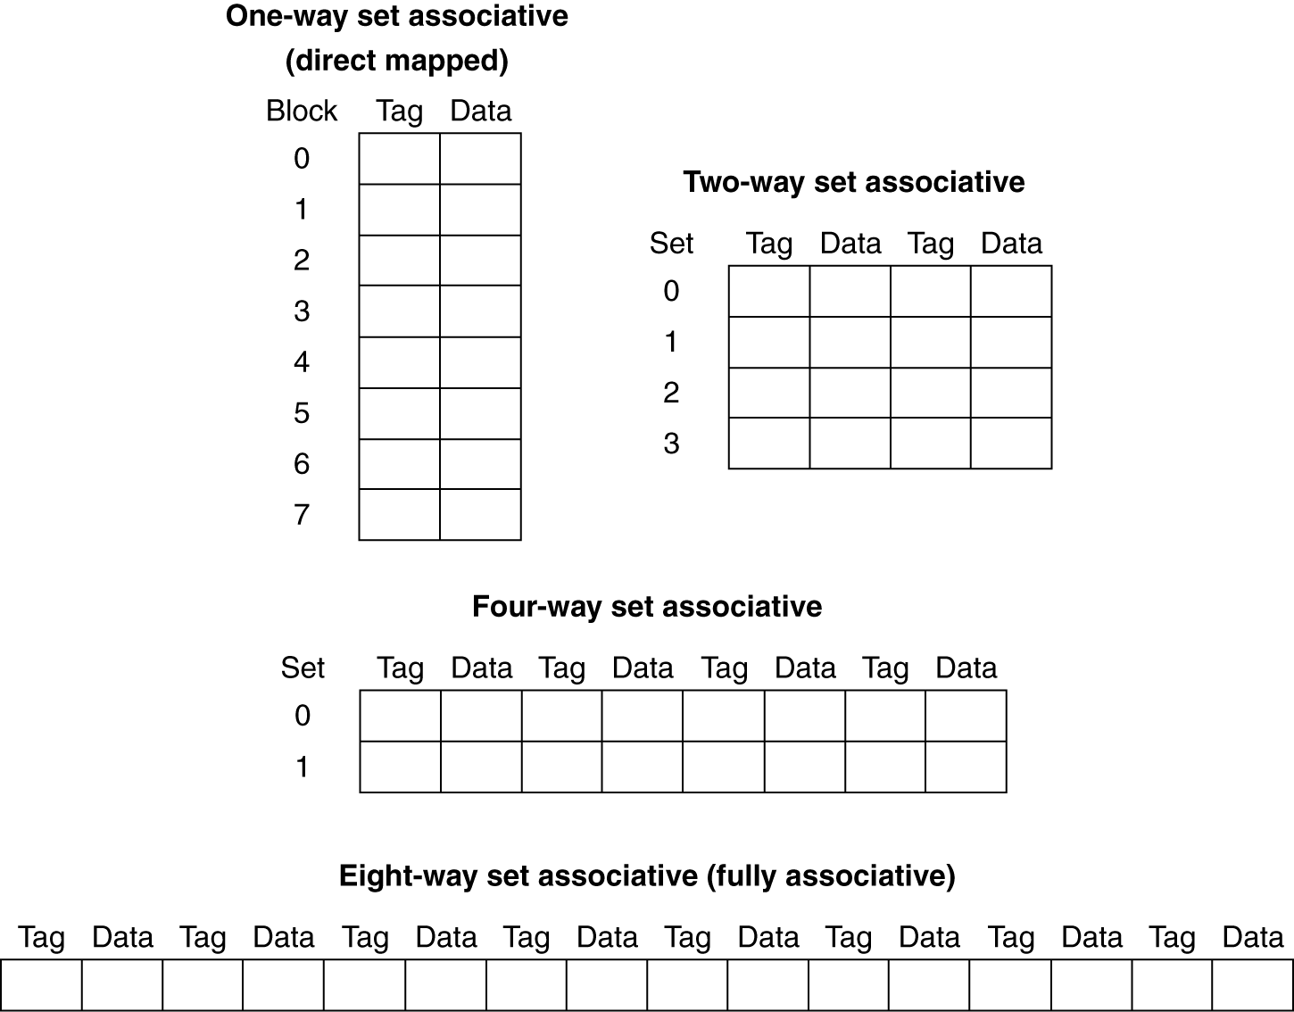
Spectrum of Associativity
For a cache with 8 entries
404

Slide 41
Associativity Example
Compare 4-block caches
Direct mapped, 2-way set associative, fully associative
Block access sequence: 0, 8, 0, 6, 8
Direct mapped
Block address | Cache index | Hit/miss | Cache content after access
 |  |  | 0 | 1 | 2 | 3
0 | 0 | miss | Mem[0]
8 | 0 | miss | Mem[8]
0 | 0 | miss | Mem[0]
6 | 2 | miss | Mem[0] |  | Mem[6]
8 | 0 | miss | Mem[8] |  | Mem[6]
405

Slide 42
Associativity Example
2-way set associative
Block address | Cache index | Hit/miss | Cache content after access
 |  |  | Set 0 |  | Set 1
0 | 0 | miss | Mem[0]
8 | 0 | miss | Mem[0] | Mem[8]
0 | 0 | hit | Mem[0] | Mem[8]
6 | 0 | miss | Mem[0] | Mem[6]
8 | 0 | miss | Mem[8] | Mem[6]
Fully associative
Block address |  | Hit/miss | Cache content after access
0 |  | miss | Mem[0]
8 |  | miss | Mem[0] | Mem[8]
0 |  | hit | Mem[0] | Mem[8]
6 |  | miss | Mem[0] | Mem[8] | Mem[6]
8 |  | hit | Mem[0] | Mem[8] | Mem[6]
406

Slide 43
How Much Associativity
Increased associativity decreases miss rate
But with diminishing returns
Simulation of a system with 64KB D-cache, 16-word blocks, SPEC2000
1-way: 10.3%
2-way: 8.6%
4-way: 8.3%
8-way: 8.1%
407

Slide 44
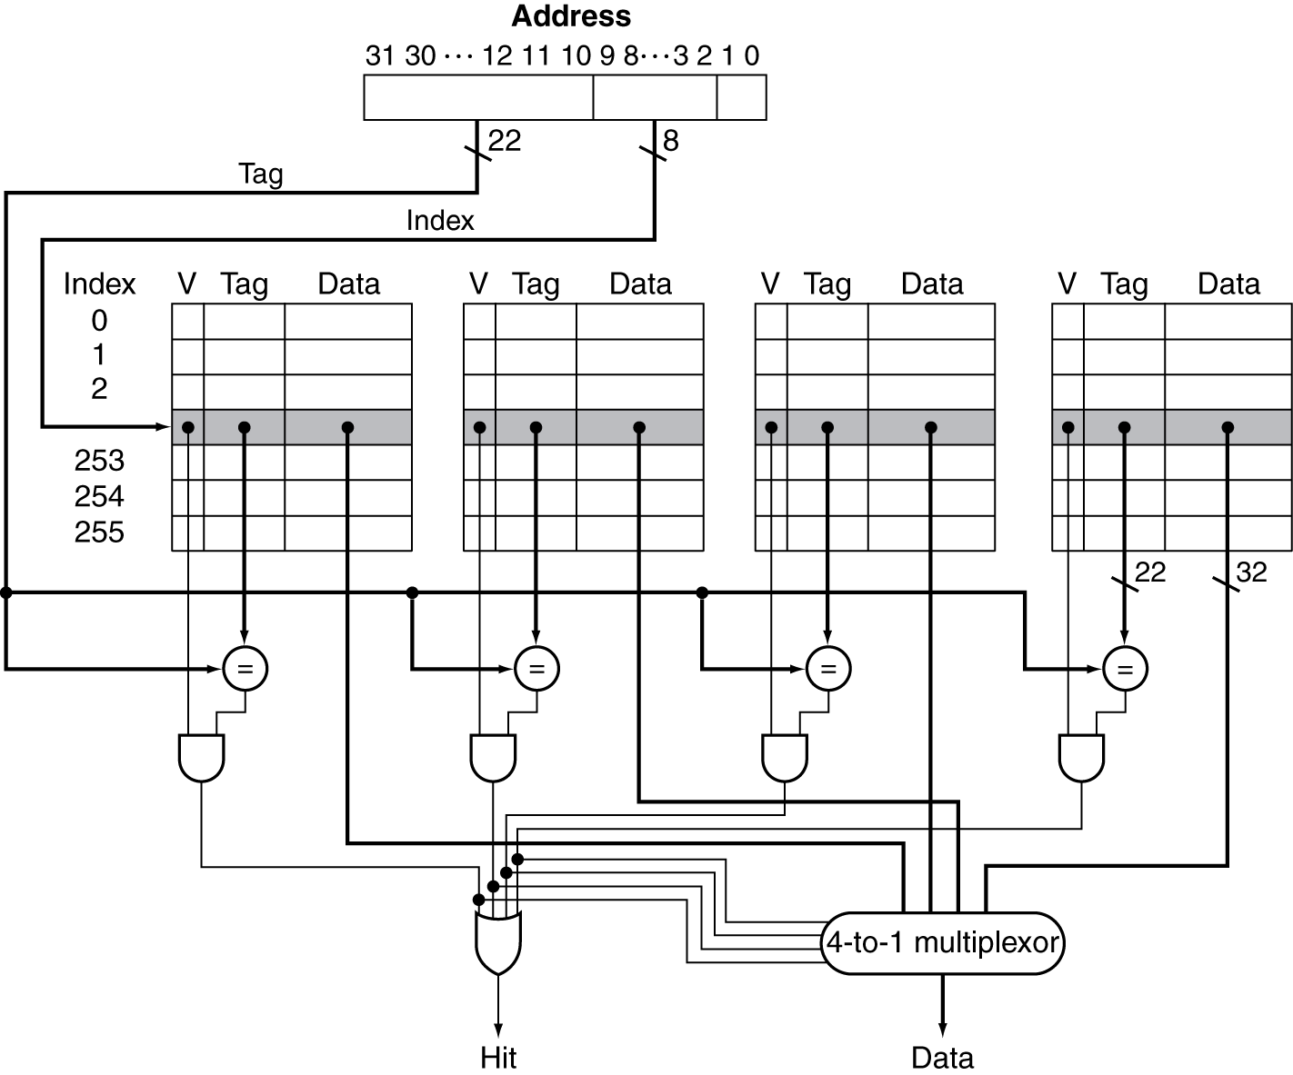
Set Associative Cache Organization
406

Slide 45
Replacement Policy
Direct mapped: no choice
Set associative
Prefer non-valid entry, if there is one
Otherwise, choose among entries in the set
Least-recently used (LRU)
Choose the one unused for the longest time
Simple for 2-way, manageable for 4-way, too hard beyond that
Random
Gives approximately the same performance as LRU for high associativity
409

Slide 46
Multilevel Caches
Primary cache attached to CPU
Small, but fast
Level-2 cache services misses from primary cache
Larger, slower, but still faster than main memory
Main memory services L-2 cache misses
Some high-end systems include L-3 cache
410

Slide 47
Multilevel Cache Example
Given
CPU base CPI = 1, clock rate = 4GHz
Miss rate/instruction = 2%
Main memory access time = 100ns
With just primary cache
Miss penalty = 100ns/0.25ns = 400 cycles
Effective CPI = 1 + 0.02 × 400 = 9
410

Slide 48
Example (cont.)
Now add L-2 cache
Access time = 5ns
Global miss rate to main memory = 0.5%
Primary miss with L-2 hit
Penalty = 5ns/0.25ns = 20 cycles
Primary miss with L-2 miss
Extra penalty = 500 cycles
CPI = 1 + 0.02 × 20 + 0.005 × 400 = 3.4
Performance ratio = 9/3.4 = 2.6
410

Slide 49
Multilevel Cache Considerations
Primary cache
Focus on minimal hit time
L-2 cache
Focus on low miss rate to avoid main memory access
Hit time has less overall impact
Results
L-1 cache usually smaller than a single cache
L-1 block size smaller than L-2 block size

Slide 50
Interactions with Advanced CPUs
Out-of-order CPUs can execute instructions during cache miss
Pending store stays in load/store unit
Dependent instructions wait in reservation stations
Independent instructions continue
Effect of miss depends on program data flow
Much harder to analyse
Use system simulation

Slide 51
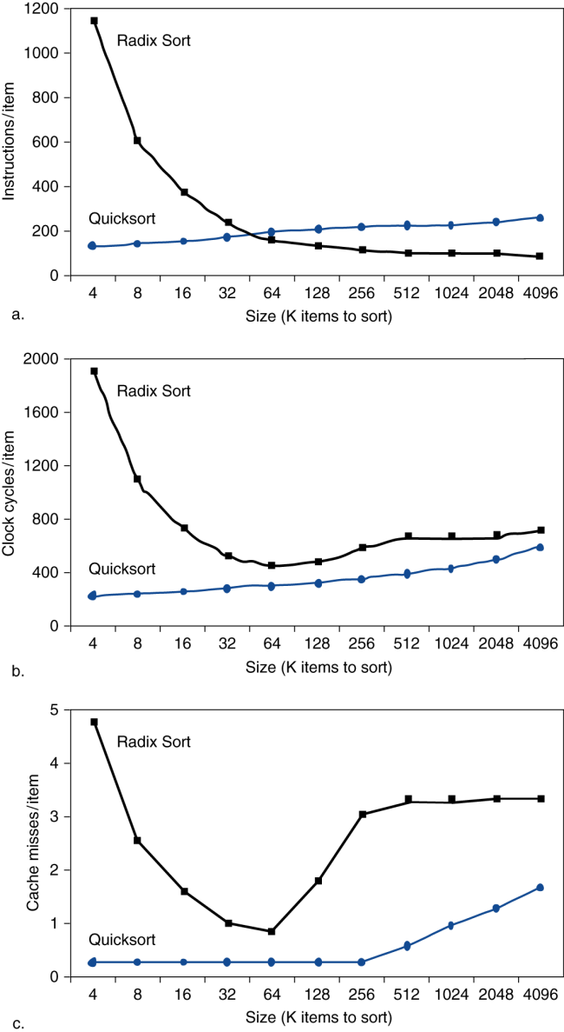
Interactions with Software
Misses depend on memory access patterns
Algorithm behavior
Compiler optimization for memory access
412

Slide 52
DGEMM Matrix Multiply Optimizations
Basic concept:
=
x
But cache use is very unoptimized
Instead, break problem into sub-problems
414

Slide 53
Optimization Comparisons
416

Slide 54
Dependable Memory Hierarchy
Service accomplishment, where the service is delivered as specified
Service interruption, where the delivered service is different from the specified service
Thus, require service-level agreement
418

Slide 55
Availability
Mean Time to Fail (MTTF)
Mean Time to Repair (MTTR)
Mean Time Between Failures (MTBF)
MTTF + MTTR
Availability: MTTF/MTBF
419

Slide 56
Hamming ECC
Memory is no good if it isn’t reliable
Bit failures increase with time
Can use parity to detect errors
But parity alone can’t correct errors
Except for one bit
Can use an interplay of parities to correct single failures in more bits
420

Slide 57
How Hamming ECC Works
Start numbering bits from 1 on the left, as opposed to the traditional numbering of the rightmost bit being 0.
Mark all bit positions that are powers of 2 as parit
All other bit positions are used for data bits (positions 3, 5, 6, 7, 9, 10, 11, 12, 13, 14, 15, . .. ).y bits (positions 1, 2, 4, 8, 16, ... ) .
Parity bit 2n check is parity for bits whose position number has bit n = 1.
420

Slide 58
Hamming ECC
Bit position | 1 | 2 | 3 | 4 | 5 | 6 | 7 | 8 | 9 | 10 | 11 | 12
 | p1 | p2 | d1 | p4 | d2 | d3 | d4 | p8 | d5 | d6 | d7 | d8
 | 1 | 0 | 0 | 0 | 1 | 0 | 0 | 1 | 0 | 0 | 0 | 1
Bit 0 =1
Bit 1 = 1
Bit 2 = 1
Bit 3 = 1
P1 is even parity for d1, d2, d4, d5, and d7 (0, 1, 0, 0, 0) = 1
P2 is even parity for d1, d3, d4, d6, d7 (0, 0, 0, 0, 0) = 0
P4 is even parity for d2, d3, d4 and d8 (1, 0, 0, 1) = 0
P8 is even parity for d5, d6, d7, d8 (0, 0, 0, 1) = 1
421

Slide 59
How it works
Bit position | 1 | 2 | 3 | 4 | 5 | 6 | 7 | 8 | 9 | 10 | 11 | 12
 | p1 | p2 | d1 | p4 | d2 | d3 | d4 | p8 | d5 | d6 | d7 | d8
 | 1 | 0 | 0 | 0 | 1 | 0 | 0 | 1 | 0 | 1 | 0 | 1
A single bit has been flipped in the above example
Recompute parity bits:
P1 is even parity for d1, d2, d4, d5, and d7 (0, 1, 0, 0, 0) = 1
P2 is even parity for d1, d3, d4, d6, d7 (0, 0, 0, 1, 0) = 1 (p2 miscompare)
P4 is even parity for d2, d3, d4 and d8 (1, 0, 0, 1) = 0
P8 is even parity for d5, d6, d7, d8 (0, 1, 0, 1) = 0 (p8 miscompare)
Which bit do P2 and P8 have in common?
P1: d1 d2 d3 d4 d5 d6 d7 d8 (parity OK)
P2: d1 d2 d3 d4 d5 d6 d7 d8 (parity not OK)
P4: d1 d2 d3 d4 d5 d6 d7 d8 (parity OK)
P8: d1 d2 d3 d4 d5 d6 d7 d8 (parity not OK)
Or, P2¹ and P2³ are in error, so set bits 1 and 3 to 1 and other bits to 0 in a binary number: 0000 1010 = 10 which is the bit position of d6.(or 8 + 2)

Slide 60
Virtual Memory, Virtual Machines
The protection racket
Page based virtual memory is the basis of process protection
Need process protection if more than one process is running at once
Architecture must allow
At least a user and OS process mode
Allow user privilege read only access to some OS info
Allow processor to switch privilege levels
Protect memory state of a process from another process
Most popular method is state bits attached to pages
428

Slide 61
What is Virtual Memory
Like cache, but
Processor address width determines VM size
Cache operations are governed by hardware, VM is a property of the operating system
Main memory is the complete backing store for cache, but the disk file contains more than the backing store for VM pages.
428

Slide 62
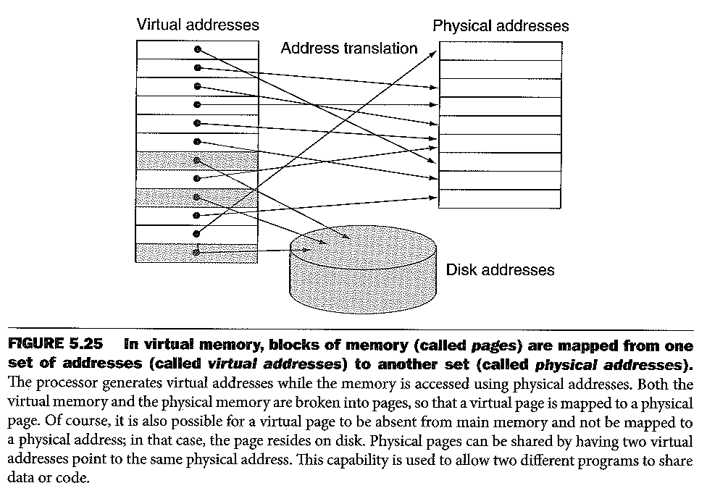
Address translation
429

Slide 63
Address Translation
Large size of page table means it is paged
Would cause a double-time hit
One to get the page of the page table
A second to get the data from the page
TLB holds parts of the page table and leverages locality to speed address translation
If all worked perfectly, we’d be done
428

Slide 64
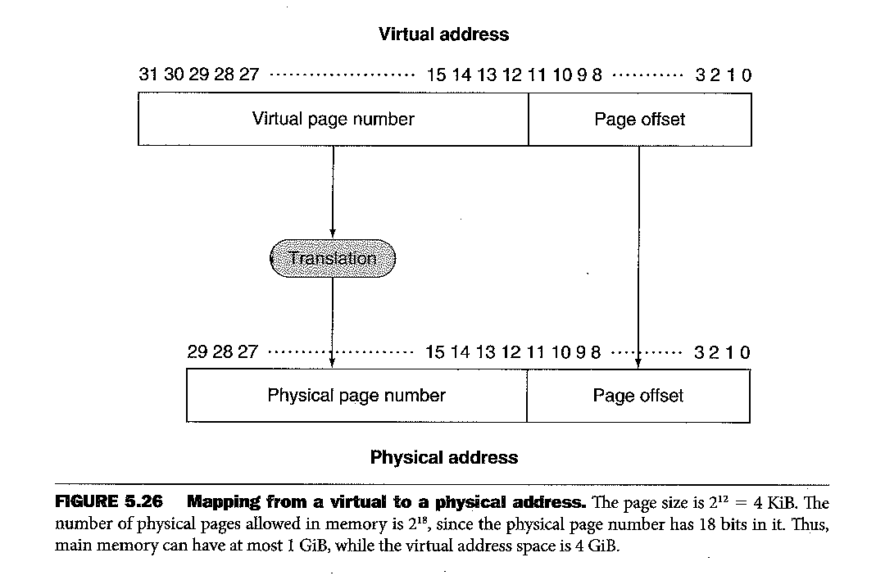
Address translation
430

Slide 65
The four cache questions
Where can a block (page) be placed in memory?
In principle, anywhere, main memory is seen as fully associative in regard to pages
How is a block found in main memory?
The page table and the Translation Lookaside Buffer
What block should be replaced, if needed?
Same as cache--LRU
What happens on a write?
Typically write-back
431

Slide 66
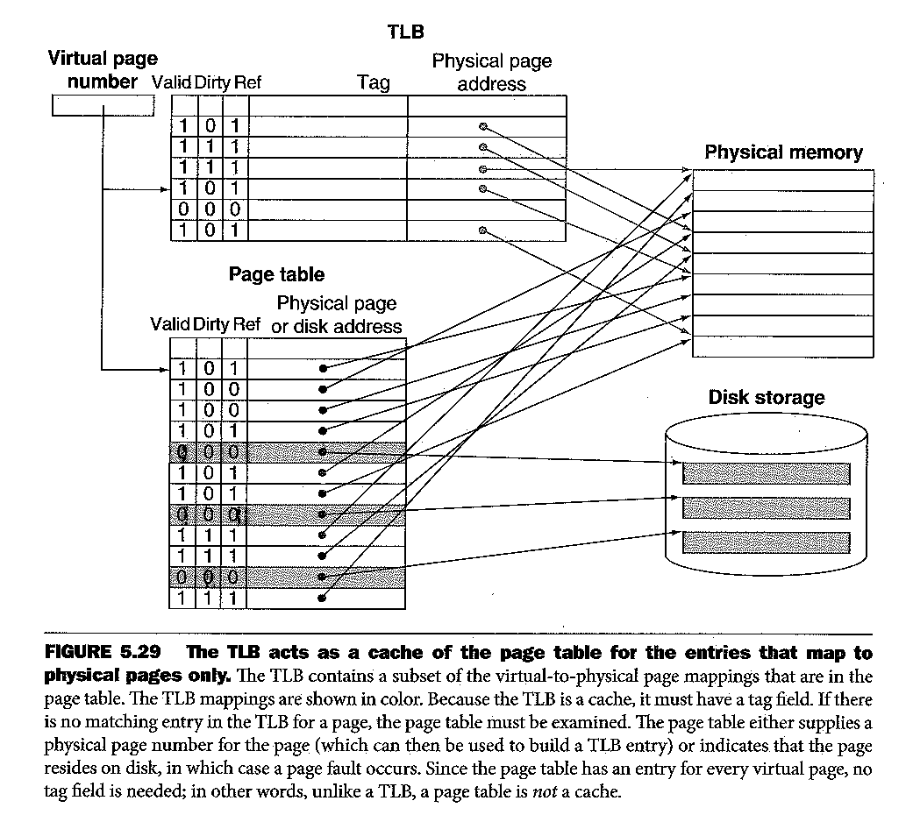
Translation Looksaside Buffer
438

Slide 67
Putting Cache and Virtual Memory Together
This cache is physically indexed and tagged
Cache is hardware
Virtual memory is software
441

Slide 68
Combination of Hits and Misses
443

Slide 69
Implementing Protection
Processor has two modes, user and kernel
Operating system manages virtual memory with kernel-level instructions and calls
A context switch isolates one process’s page table from another process’s
444

Slide 70
Virtual Memory in MIPS
These are the MIPS registers used to handle virtual memory
Page faults are restartable exceptions
448

Slide 71
MIPS TLB Miss Handler
Context and EntryLo are Coprocessor 0 registers shown on previous slide
Mfc0, mtc0 and eret are legal instructions in MARS, but the C0 registers are not all there
Tlbwr is a kernel-privilege instruction only (not supported by MARS)
449

Slide 72
Virtual Memory Summary
Pages are large (4K) compared to cache block sizes
Must map between virtual addresses and physical addresses
Main memory handles pages in fully associative fashion
LRU important replacement strategy since page faults take a long time to service
452

Slide 73
Thrashing
When main memory is small and page faults are frequent
Belady’s anomaly
Increasing main-memory size leads to more page faults
From early virtual memory schemes which didn’t use LRU replacement strategy
453

Slide 74
Common Framework for Cache and Virtual Memory
Where can block be placed?
How is it found again?
Which block should be replaced on a miss?
How are writes different?
454

Slide 75
The Three C’s for Misses
Compulsory
On first-ever access
Capacity
No room
Conflict
Room, but not in the set
459

Slide 76
Overall Miss Rate vs Cache Size
460

Slide 77
Fixes and Their Drawbacks
Design change | Effect on miss rate | Negative performance effect
Increase cache size | Decrease capacity misses | May increase access time
Increase associativity | Decrease conflict misses | May increase access time
Increase block size | Decrease compulsory misses | Increases miss penalty. For very large block size, may increase miss rate due to pollution.
461

Slide 78
Say We Want to Design a Cache Controller
Requirements
Direct-mapped
Write-back using write allocate
Block size is 16 bytes (Block index = 4 bits)
Cache size is 16 KB (Set index = 10 bits)
32-byte addresses
Valid bit and dirty bit per block
Therefore cache tag is 18 bits
462

Slide 79
Data Lines
Requirements
1-bit Read or Write signal
1-bit Valid signal, saying whether there is a cache operation or not
32-bit address
32-bit data from processor to cache
32-bit data from cache to processor
1-bit Ready signal, saying the cache operation is complete
462

Slide 80
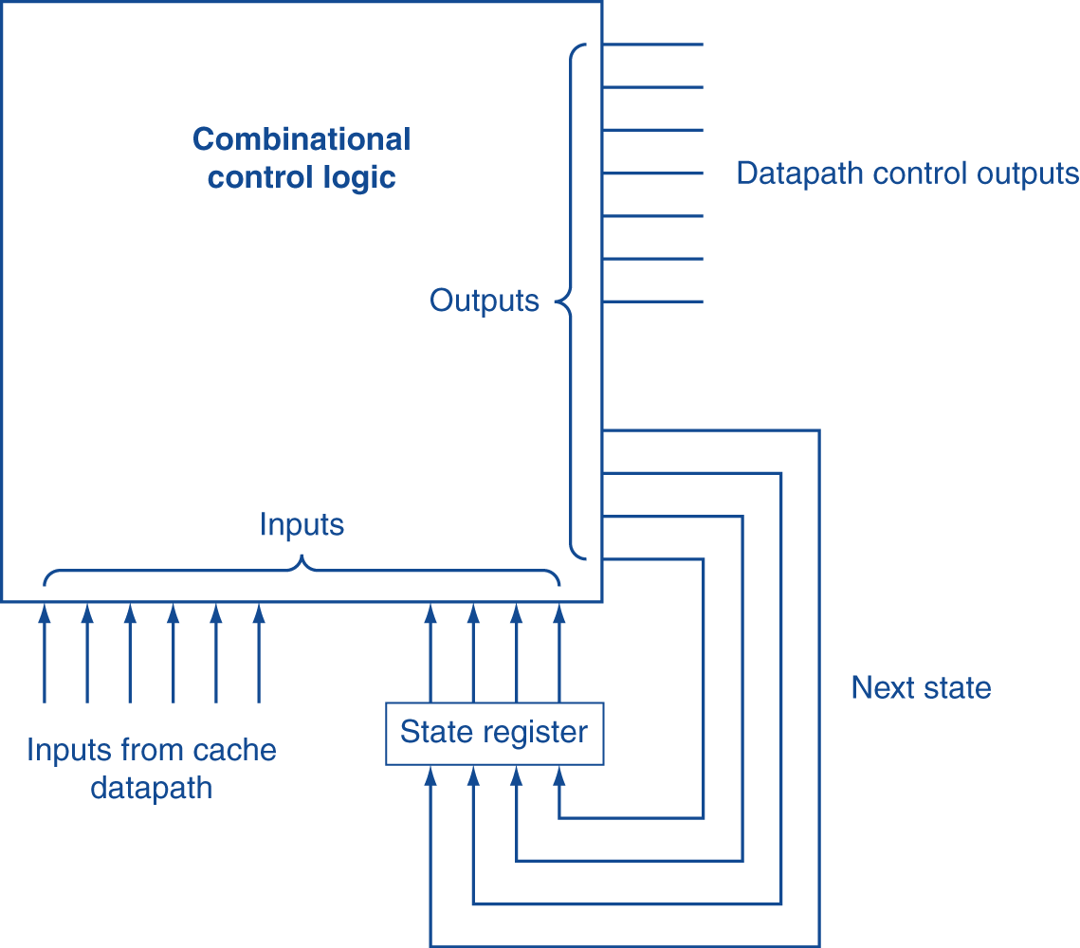
General Controller Circuit
To CPU and memory
From CPU and memory
464

Slide 81
Final State Machine
Read or Write Hit
Read or Write Miss
Invalid block available
Or evicted block clean
Read or Write Miss
Invalid block dirty
465

Slide 82
Interface Signals
CPU
Cache
Memory
Read/Write
Read/Write
Valid
Valid
Address
32
Address
32
Write Data
32
Write Data
128
Read Data
32
Read Data
128
Ready
Ready
Multiple cycles per access

Slide 83
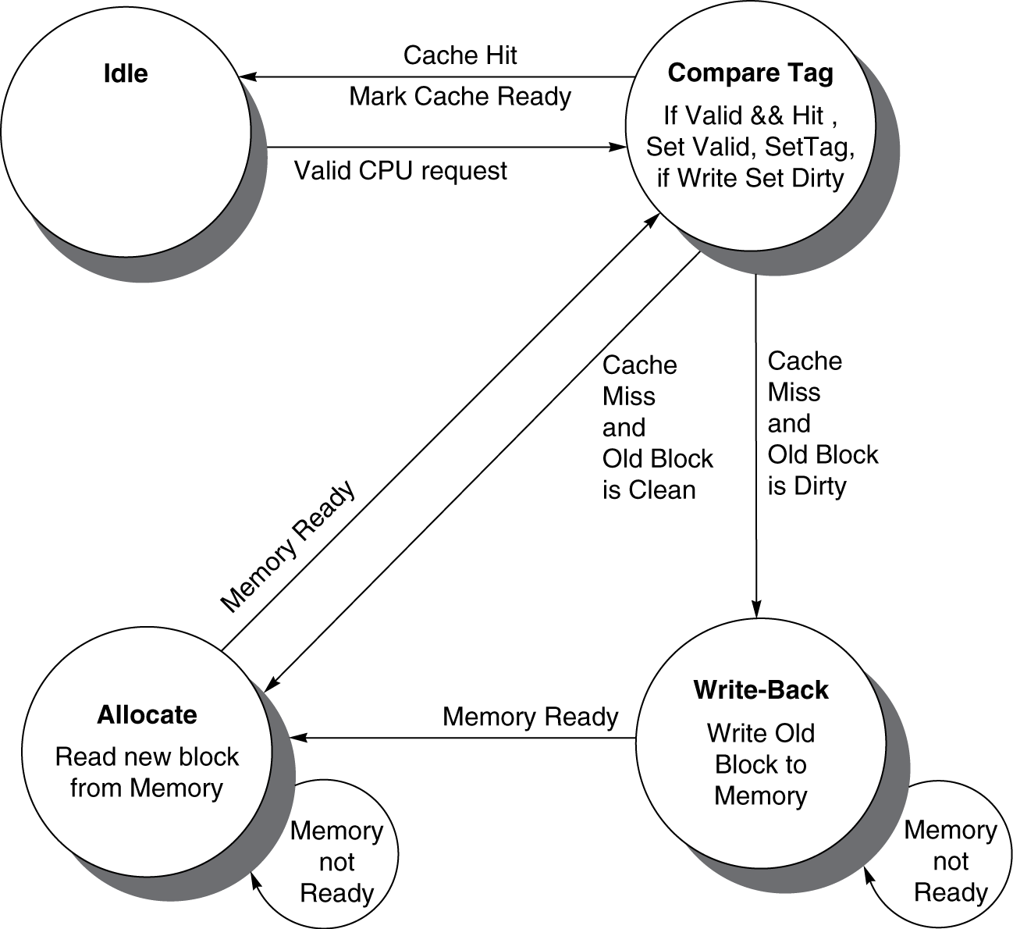
Cache Controller FSM
Could partition into separate states to reduce clock cycle time
465

Slide 84
Coherence Defined
Informally: Reads return most recently written value
Formally:
P writes X; P reads X (no intervening writes) ⇒ read returns written value
P₁ writes X; P₂ reads X (sufficiently later) ⇒ read returns written value
c.f. CPU B reading X after step 3 in example
P₁ writes X, P₂ writes X ⇒ all processors see writes in the same order
End up with the same final value for X
466

Slide 85
Cache Coherence Problem
Suppose two CPU cores share a physical address space
Write-through caches
Time step | Event | CPU A’s cache | CPU B’s cache | Memory
0 |  |  |  | 0
1 | CPU A reads X | 0 |  | 0
2 | CPU B reads X | 0 | 0 | 0
3 | CPU A writes 1 to X | 1 | 0 | 1
467

Slide 86
Cache Coherence Protocols
Operations performed by caches in multiprocessors to ensure coherence
Migration of data to local caches
Reduces bandwidth for shared memory
Replication of read-shared data
Reduces contention for access
Snooping protocols
Each cache monitors bus reads/writes
Directory-based protocols
Caches and memory record sharing status of blocks in a directory
468

Slide 87
Invalidating Snooping Protocols
Cache gets exclusive access to a block when it is to be written
Broadcasts an invalidate message on the bus
Subsequent read in another cache misses
Owning cache supplies updated value
CPU activity | Bus activity | CPU A’s cache | CPU B’s cache | Memory
 |  |  |  | 0
CPU A reads X | Cache miss for X | 0 (shared) |  | 0
CPU B reads X | Cache miss for X | 0 (shared) | 0 (shared) | 0
CPU A writes 1 to X | Invalidate for X | 1(modify) | (invalidate) | 0
CPU B read X | Cache miss for X | 1 (shared) | 1 (shared) | 1
469

Slide 88
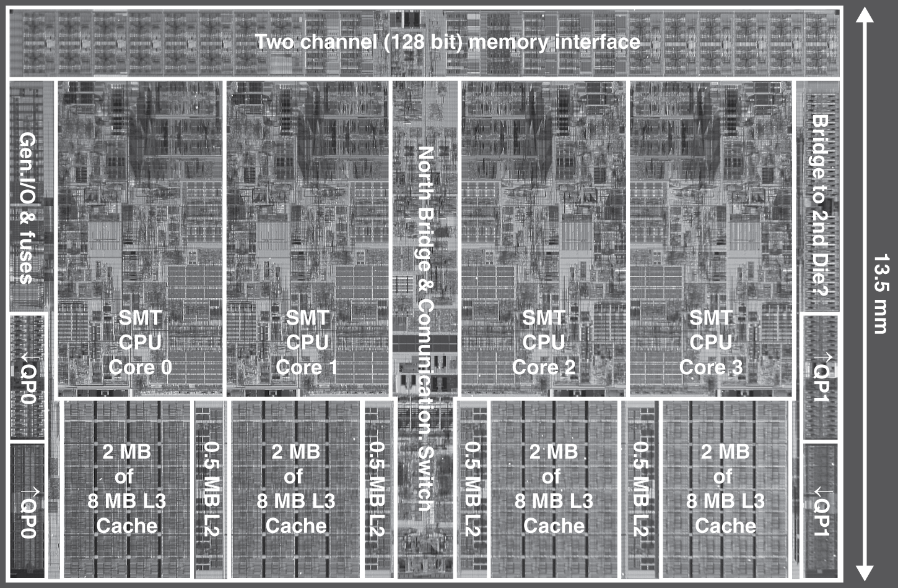
Multilevel On-Chip Caches
Intel Nehalem 4-core processor
§5.10 Real Stuff: The AMD Opteron X4 and Intel Nehalem
Per core: 32KB L1 I-cache, 32KB L1 D-cache, 512KB L2 cache

Slide 89
A-8 vs i7
471

Slide 90
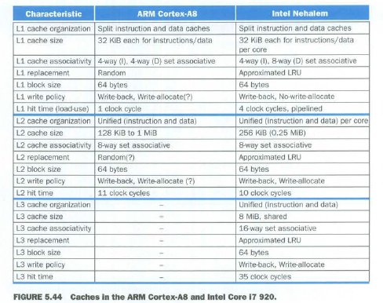
A-8 vs i7 Caches
A9 also has only 2 levels
472

Slide 91
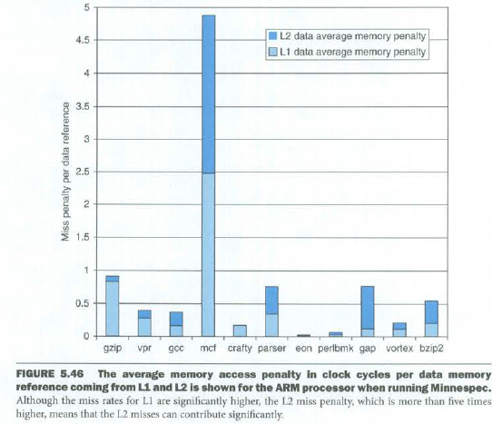
Memory Performance: A-8
474

Slide 92
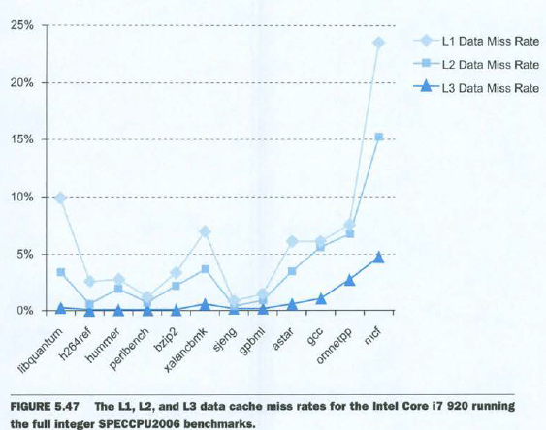
Memory Performance: i7
475

Slide 93
DGEMM Matrix Multiply Optimizations
Basic concept:
=
x
But cache use is very unoptimized
Instead, break problem into sub-problems
476

Slide 94
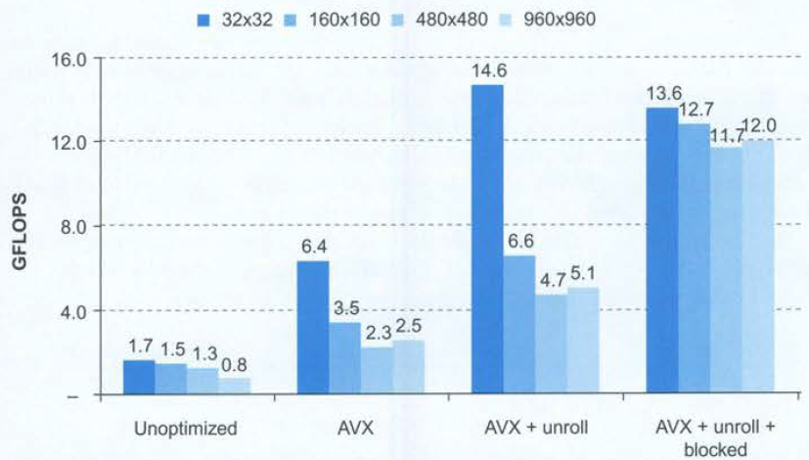
Optimization Comparisons
477

